Slide 1

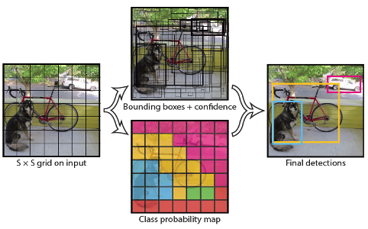
Research Summer School for Glasgow College UESTC (2019-20)
Deep Learning enabled Real-time Object Detection on a live video stream
Name : Haoyu Liu
UoG Number : 2429428L
Grade : Sophomore

Slide 2


Aim
Preparation
A real-time object detector
1. Develop practical skills
Sense the environment
Parse the scene
React accordingly
2. Develop a basic
understanding of YOLO
(i) Identify the types
(ii) Locate the object
3. Develop a code to perform
live object detection

Slide 3
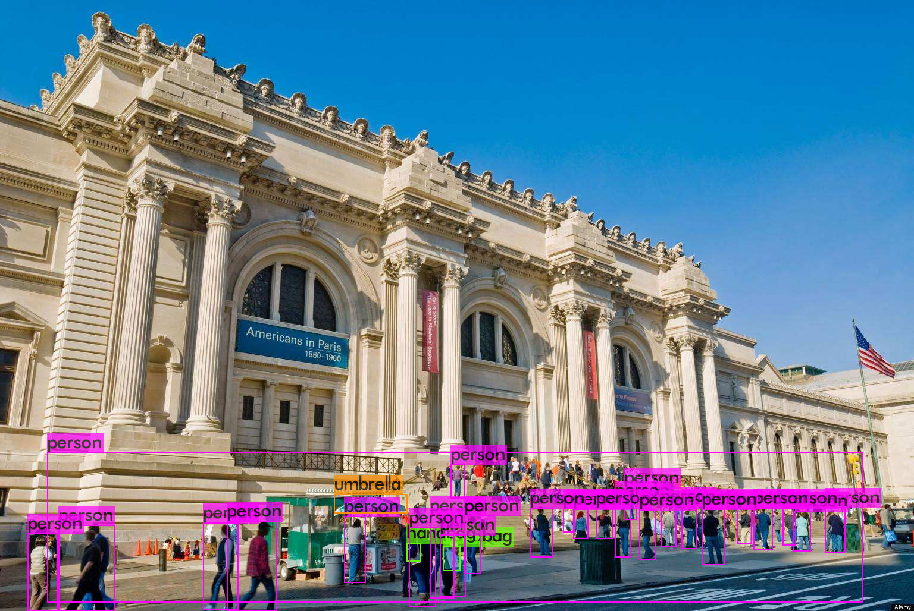
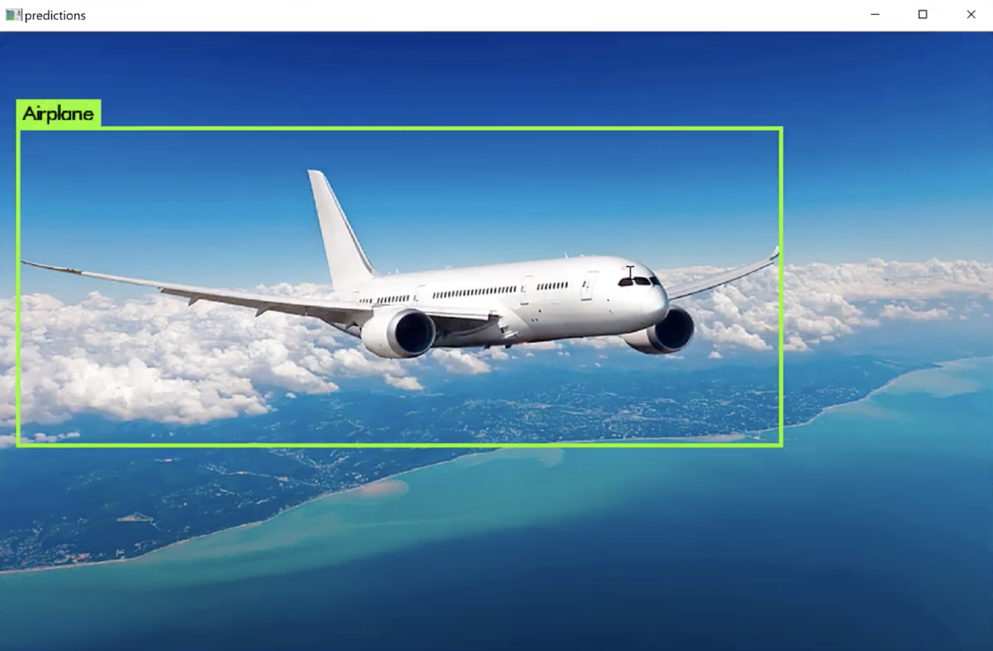
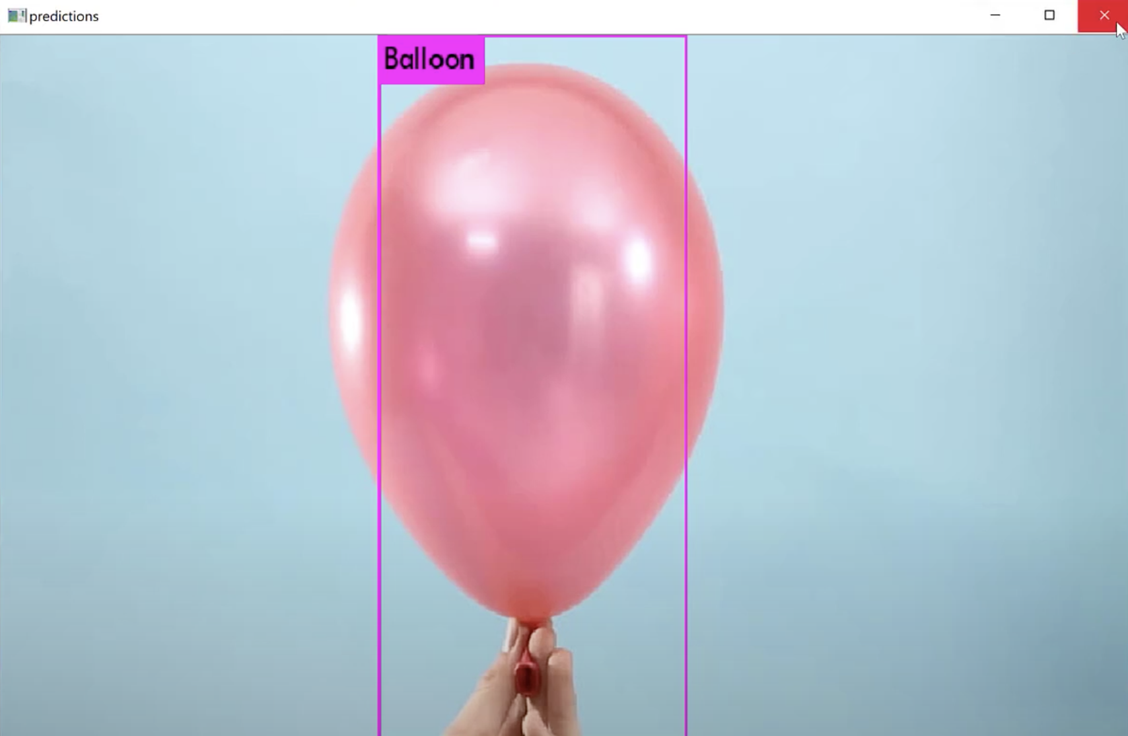

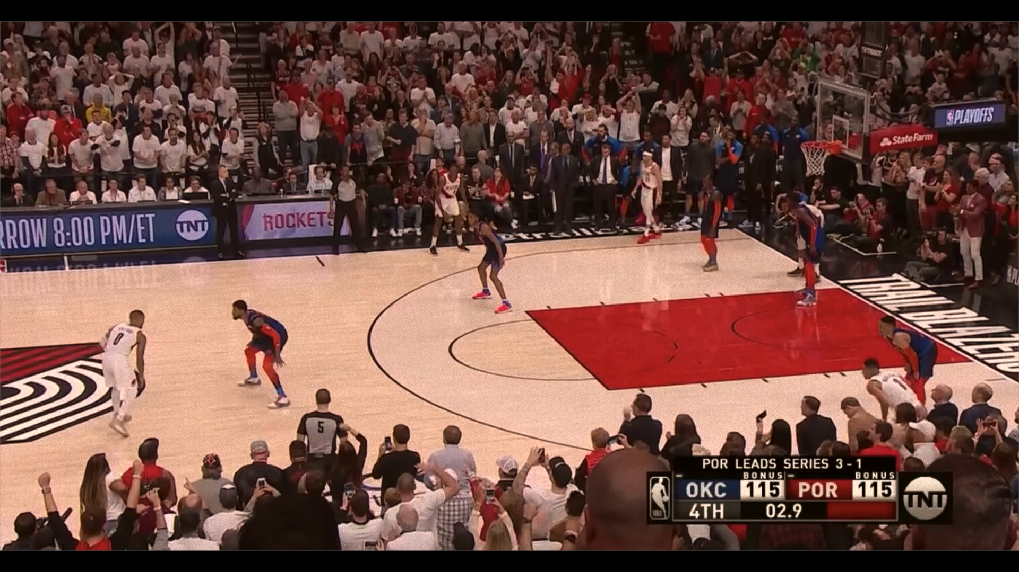
Methodology
Results
YOLOv3
COCO Dataset
Custom Dataset—Balloon and Airplane
Google Open Images
YOLOv4
COCO Dataset
Custom Dataset—Vehicle License Plate
Google Open Images

Slide 4


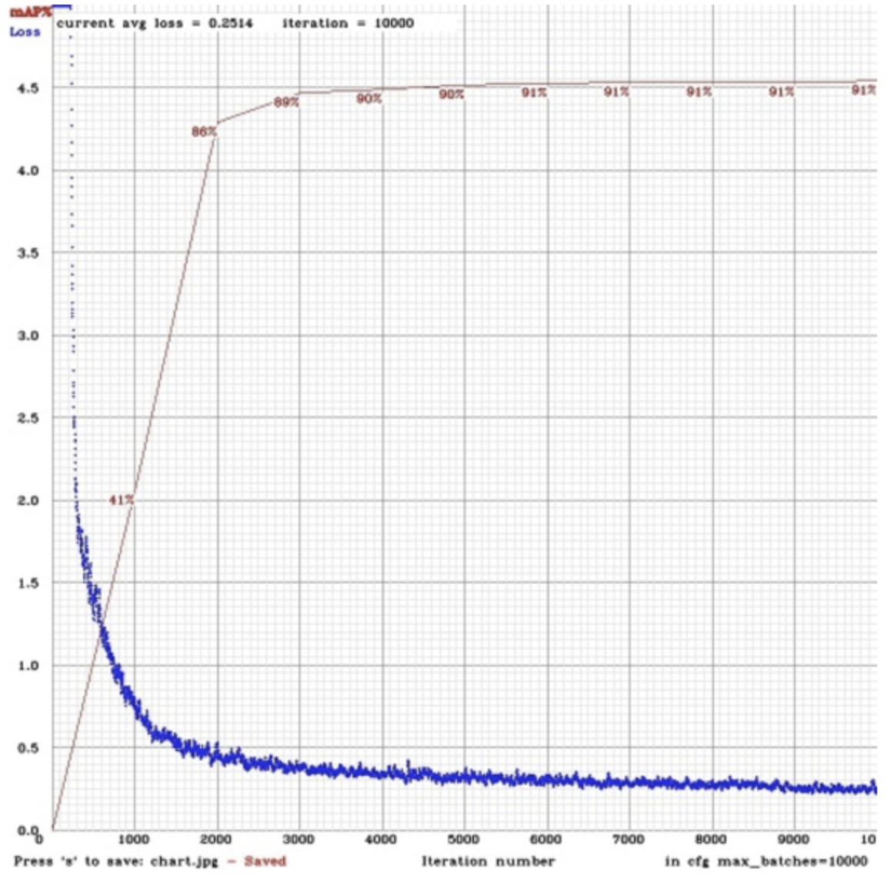

Key Results
Enhancement--YOLOv3
darknet-19->darknet-53
softmax->logistic
predictions across scales
mAP of my model : 88.57%
Q&A
Future Work
Compare with other object detector algorithm
Improve the performance of YOLO

